Slide 1

Event Handling in Java_{TM}
Introducing the basics of GUIs and event-handling in Java

Slide 2

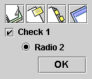
GUI components
Buttons
  Common buttons
  Radio buttons
  Check buttons

Slide 3

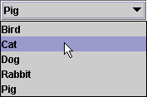
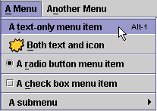
GUI components
Combo boxes
Lists
Menus

Slide 4


GUI components
Spinners
Sliders
Textfields

Slide 5
Console vs. GUI applications
What is the difference between a GUI and a console app?
From the programmer’s perspective?
A console app enables interaction through a specified “flow” of I/Os. A GUI app makes it much more flexible. The user is allowed to perform combinations of actions. The programmer must have taken all possible behaviors in mind.

Slide 6
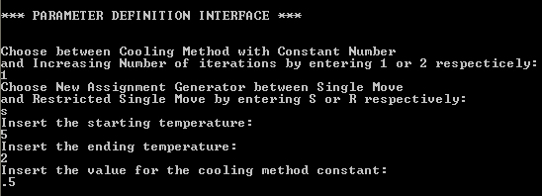
Console vs. GUI applications
The app controls the type and order of the interactions

Slide 7
GUI classes
Components you use to build a GUI app, are instances of classes contained in the javax.swing package:
  JButton
  JTextField
  JRadioButton
  JCheckBox
  JComboBox
  JLabel etc…

Slide 8
Building GUIs essentials
A GUI consists of a number of components contained in some pane.
To appear onscreen, every GUI component must be part of a containment hierarchy. A containment hierarchy is a tree of components that has a top-level container as its root.
For Java apps this top-level container will typically be a JFrame.
Components will then be “pinned” on the top-level container’s content pane.

Slide 9
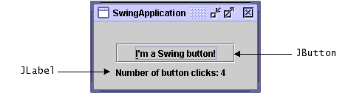
Building GUIs essentials
JFrame object
Container object
JButton object
JLabel object

Slide 10
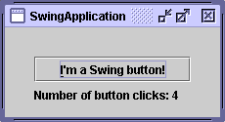
Building GUIs essentials
Putting this in code:
import javax.swing.*;
public class MyApp extends JFrame{
private JButton b1;
private JLabel l1;
Public MyApp(){
super(“SwingApplication");
Container myCont = getContentPane();
b1=new JButton(“I’m a Swing button!”);
l1= new JLabel(“Number of button clicks: “ + num);
myCont.add(b1);
myCont.add(l1);
}

Slide 11
GUI components again…
JButton:
  JButton(Icon i)
  JButton(String s)
  JButton(Icon i, String s)
JTextField:
  JTextField()
  JTextField(int cols)
  JTextField(String s, int cols)
  JTextField(String s)

Slide 12
…and again…
JList:
  JList()
  JList(Vector v)
  Example:
  String[] data = {"one", "two", "three", "four"};
  JList dataList = new JList(data);
  dataList.add(“five”);

Slide 13
…and again
JRadioButton:
  JRadioButton(String s, Icon i, boolean state)
  Example:
  JRadioButton rb1= new JRadioButton(“one”);
  JRadioButton rb2= new JRadioButton(“two”);
  ButtonGroup bg= new ButtonGroup();
  bg.add(rb1);
  bg.add(rb2);

Slide 14
Layout Managers
You use layout managers to design your GUIs.
There are several managers like:
  FlowLayout
  BorderLayout
  GridLayout
  CardLayout
  GridBagLayout

Slide 15

FlowLayout
Default layout
Components laid out from the top-left corner, from left to right and top to bottom like a text.

Slide 16
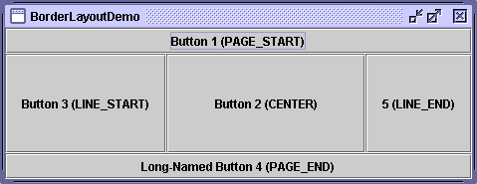
BorderLayout
Places components in up to five areas: top, bottom, left, right, and center. All extra space is placed in the center area

Slide 17
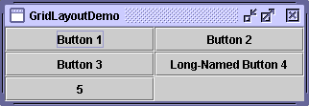
GridLayout
Simply makes a bunch of components equal in size and displays them in the requested number of rows and columns

Slide 18
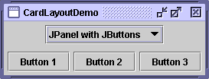
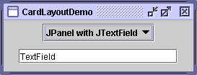
CardLayout
lets you implement an area that contains different components at different times. A CardLayout is often controlled by a combo box, with the state of the combo box determining which panel (group of components) the CardLayout displays

Slide 19
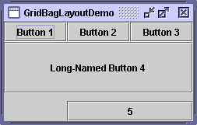
GridBagLayout
is a sophisticated, flexible layout manager. It aligns components by placing them within a grid of cells, allowing some components to span more than one cell.

Slide 20
Layout Managers
Putting it into code:
  Setting the manager:
  Container myCont = getContentPane();
  myCont.setLayout(new FlowLayout());
  Adding Components:
  myCont.add(aComponent, BorderLayout.WEST);

Slide 21
The delegation model
Sources:
  The mouse and keyboard and the GUI components (Buttons, lists, checkboxes etc.)
Events:
  Objects that describe a state change in a source.
Listeners:
  Objects notified when events occur.

Slide 22
The delegation model
Event Object
Event Source
Event Source
Listener
1st part of this presentation
The Source generates an event and sends it to the registered listener
When the state of the source changes…
The Source registers a Listener…

Slide 23
Listeners
Any number of event listener objects can listen for all kinds of events from any number of event source objects.
E.g. a program might create one listener per event source.
Or a program might have a single listener for all events from all sources.

Slide 24

Listeners
Multiple listeners can register to be notified of events of a particular type from a particular source.
Also, the same listener can listen to notifications from different objects.

Slide 25
Listeners
Each type of listeners can be notified only for its corresponding types of events which can be generated by specific types of sources.

Slide 26
Multiple sources, single listener
Many buttons can register the same listener since all buttons generate the same type of event. This type of event may be generated by other types of sources as well.
ActionListener
ActionEvent1
ActionEvent2
button1
ActionEvent3
button2
ListItem3

Slide 27

Single source, multiple listeners
A single source may generate different types of events and thus register multiple listeners.
MouseWheel Listener
MouseWheelEvent
MouseEvent
MouseMotion Listener

Slide 28
Listeners as interfaces
You implement an interface to create a listener.
In the case of a single source that generates multiple types of events you can create a single listener that implements all interfaces (remember: a class may extend only one superclass but implement more than one interfaces).

Slide 29
Single source, multiple listeners again
MouseWheel Listener
MouseWheelEvent
MouseWheel + MouseMotion Listener
MouseEvent
MouseMotion Listener

Slide 30
Sources-events-listeners
Source | Event <state change> | Listener | Methods (argument: corresponding event)
Mouse | MouseEvent <mouse clicked, pressed, dragged, moved/ entered, exited a component etc> MouseWheelEvent <page-up and down> | MouseListener MouseMotionListener MouseWheelListener | mouseClicked mousePressed mouseReleased etc mouseDragged mouseMoved mouseWheelMoved
Keyboard | KeyEvent | KeyListener | keyPressed keyReleased keyTyped

Slide 31
Sources-events-listeners
Source | Event <state change> | Listener | Methods (argument: corresponding event)
Button | ActionEvent <GUI button clicked> | ActionListener | ActionPerformed
List | ActionEvent <item double clicked> ItemEvent <item selected/deselected> | ActionListener ItemListener | ActionPerformed ItemStateChanged

Slide 32
Event handling steps
To handle an event you need 3 steps:
  Implement the appropriate interface that will produce your listener class.
  Create a listener object.
  Register the listener to the source of interest.

Slide 33
Putting it into code
You register a listener using the corresponding add function in the form: component.addSomeListener(listener_object);
You can find the source of an event by using the getSource method:
event_object.getSource();

Slide 34
Putting everything together
So you need two classes:
  The one that extends JFrame (see part one) which will create your GUI and
  The one(s) that will implement your listener(s).
  Or one that does them both!

Slide 35
Inner classes
You may create all different classes independently and put them in separate files, or…
you can implement your listeners inside the class that extends your JFrame, making it an inner class.
This enables you to put everything in one class (and hence file).

Slide 36
Adapter classes
Adapter classes are fully abstract classes that correspond to listener interfaces. They are extended (not implemented) and thus you can ignore methods that do not interest you. You can use them instead of listeners in the case that only some of the methods of the interface are to be used. You don’t use the abstract specifier and of course you cannot use multiple inheritence.
Some adapter classes:
  KeyAdapter (instead of KeyListener)
  MouseAdapter (MouseListener)
  MouseMotionAdapter (MouseMotionListener) etc…

Slide 37
Create your window (1/2)
//Extend a JFrame:
public class MyApp extends JFrame{ ...
//Declare all your components private:
private JButton b1, ...;
//Create your constructor:
Public MyApp(){
super(“SwingApplication");...
//Inside your constructor:
//Get your container:
Container myCont = getContentPane();

Slide 38
Create your window (2/2)
//Inside your constructor, set a layout:
GridBagLayout layout = new GridBagLayout(); myCont.setLayout(layout);
// Inside your constructor, create your element objects:
b1=new JButton(“I’m a Swing button!”); ...
// Inside your constructor, Add them on your content pane:
myCont.add(b1); ...
// Inside your application class, add the main method that is the entry point of your program and creates the application object:
public static void main(String[] args){
MyApp a =new MyApp();
a.setDefaultCloseOperation(JFrame.EXIT_ON_CLOSE);
}

Slide 39
Event handling in practice (1/2)
When an event is generated by a source it is handled by the listener registered by this source.
As shown, the listener is an implemented interface (or an extended adapter) and thus you have to implement some methods.
These methods take the event as an argument and this is where you put the code to be executed when the event happens.
In other words, you define what you want to happen eg. when a button is pressed, inside the actionPerformed method implemented inside the listener (also see the tables presented in part-2).
To be able to do that efficiently, the event classes define specific methods to extract information about the events.

Slide 40
Event handling in practice (2/2)
EventObject:
// superclass of all events, so the following method is inherited by all event objects
  Object getSource()
MouseEvent:
  int getX(), int getY()
  int getButton()
KeyEvent:
  char getKeyChar()
ActionEvent:
  String getActionCommand()
  long getWhen()
//This adds to the tables presented in part-2.

Slide 41
Four design options
Implement your handlers:
  in separate classes,
  using inner classes
  using anonymous inner classes,
  in the same class that creates your window.
You put everything together according to your choice.

Slide 42
Using inner classes (1/2)
This is the easiest and more practical approach.
Inner classes belong to the app class and have access to all its members.
The only thing you have to do is implement the handler and add its object to the element.

Slide 43
Using inner classes (2/2)
//Declare your handler class:
class MyHandler Implements ActionListener{ ...
//Add the actionPerformed method inside your handler class:
public void actionPerformed(ActionEvent ev){...
// Inside your app’s constructor, create your element objects:
b1=new JButton(“I’m a Swing button!”); ...
// Inside your app’ s constructor, add them on your content pane:
myCont.add(b1); ...
// Tie them together in two steps:
// Create a handler object inside the app’s constructor:
MyHandler handler = new MyHandler();
// Add it to the element:
b1.addActionListener(handler);

Slide 44
Using anonymous inner classes (1/2)
This is a variation of the previous option.
An anonymous inner class is an inner class without a name.
You define the class “on the fly” when you need an instance of it (an object) to be created.

Slide 45
Using anonymous inner classes (2/2)
//Inside the app’s constructor where you have added the component on the content pane, add the listener just as in the previous case. Only this time write its code at the same time you instantiate and add it:
b1.addActionListener(new ActionListener(){
public void actionPerformed(ActionEvent ev) {...

Slide 46
Using a separate class (1/4)
Since this does not belong to the app class, it cannot access its private members directly.
Due to the above you need to implement public access methods for each app’s element in order to be able to interact with them through the handler.

Slide 47
Using a separate class (2/4)
Apart from the above you need to pass a reference of your app object to the handler in order to tie the app and the handler together.
Using an inner class you didn’t have to do this, since the handler class belong to the app itself.
How you do this:

Slide 48
Using a separate class (3/4)
// Create a handler object inside the app’s constructor. Pass a reference to the app using this as an argument:
MyHandler handler = new MyHandler(this);
// Add it to the element (as with the inner classes):
b1.addActionListener(handler);
// Inside the handler class:
// Declare an app object:
MyApp appObj;
// Create a handler’s constructor which takes an app object as an argument. This is the app object that ties the app with the handler. Assign this object to the object declared inside your handler’s class.
public MyHandler (MyApp app){
appObj=app;
}

Slide 49
Using a separate class (4/4)
// Inside the handler class:
// Add the actionPerformed method (as previously) and access all elements through the appObj:
public void actionPerformed(ActionEvent ev)
{
if ev.getSource()==appObJ.b1{...
...
Play around! What would happen if:
  You construct a new app object inside the handler class?
  You construct it inside the actionPerformed method?

Slide 50
Using the same class (1/2)
You can make the class that extends a JFrame (the app class) to listen to its own events. This way you have all access advantages you had by using inner classes and putting everything together is easy as well.

Slide 51
Using the same class (2/2)
//Extend a JFrame and implement a handler at the same time. actionPerformed is now a method of this same class:
class MyHandler extends JFrame implements ActionListener{ ...
//Inside the app’s constructor, register the listener by using this, as the handler-adding methods need handler objects to be passed as arguments. In this case the object passed is of the very same class:
b1.addActionListener(this);

